Slide 1


Deloitte Internship Progress Update
Nur Syazwani Binti Samsawi | 2022876358

Slide 2

Contents
01
Technical Learning Path (React JS)
02
Technical Learning Path (Docker)
03
Technical Learning Path (Spring Boot)
04
Pair Project (Ticketing Support System)

Slide 3
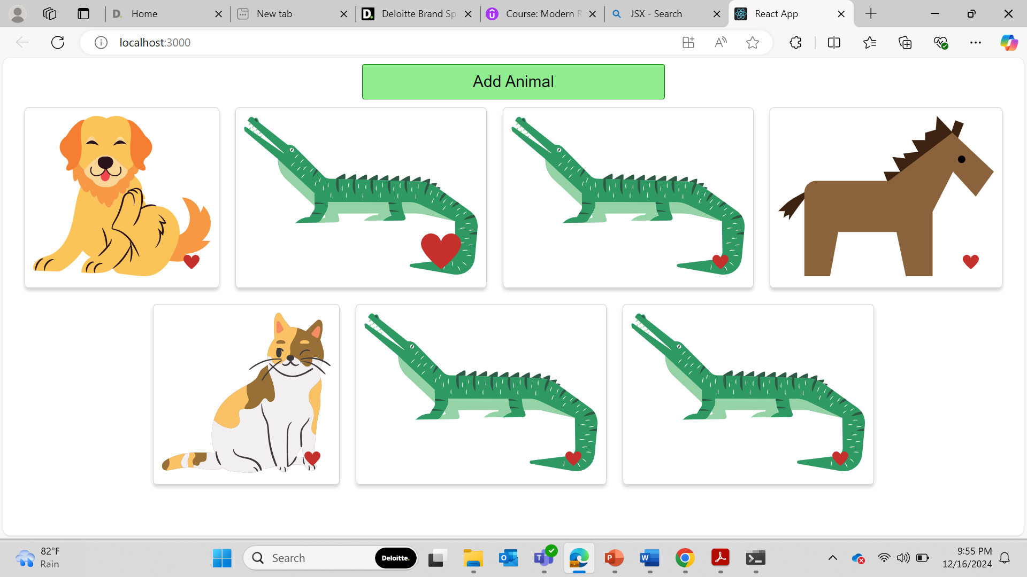
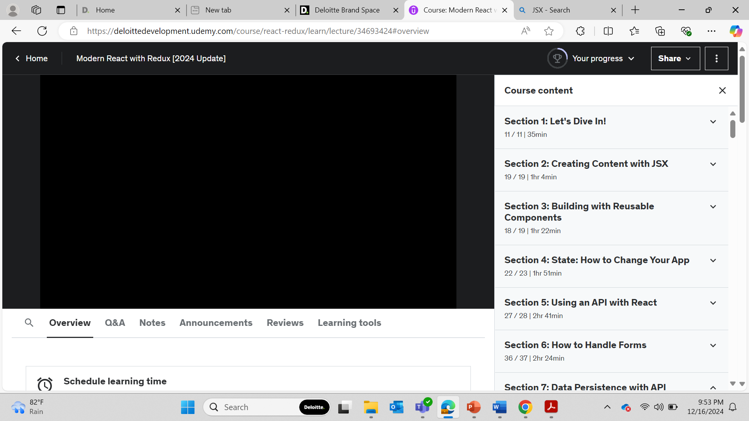

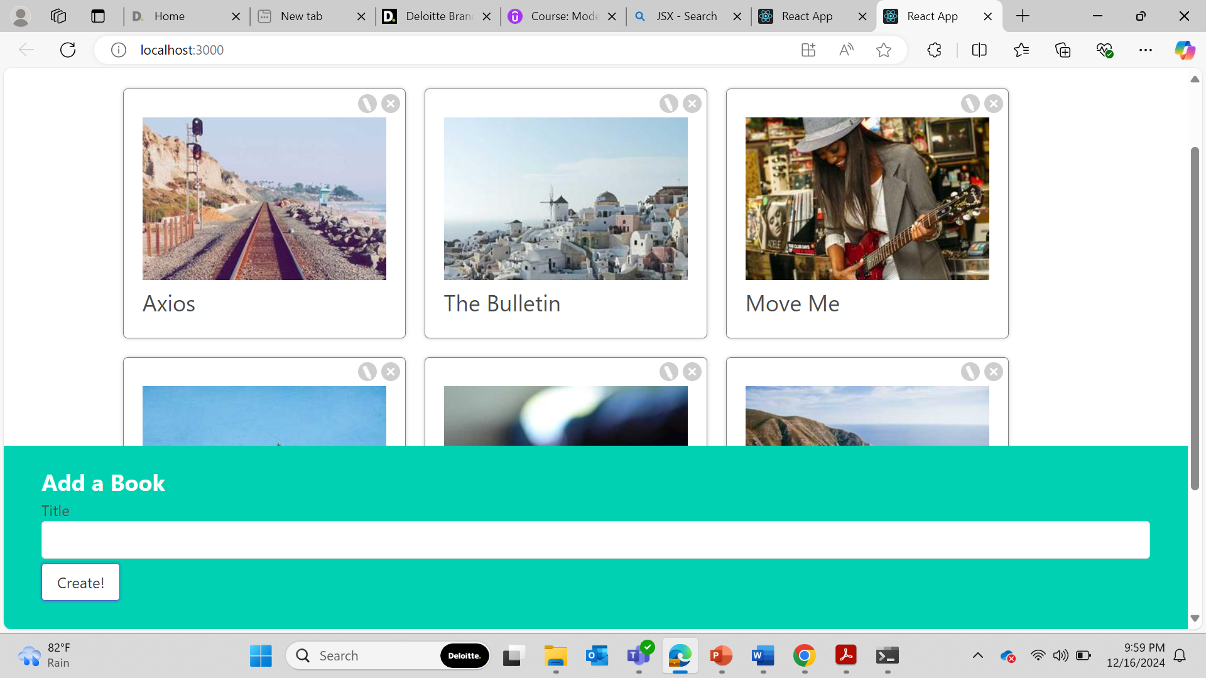
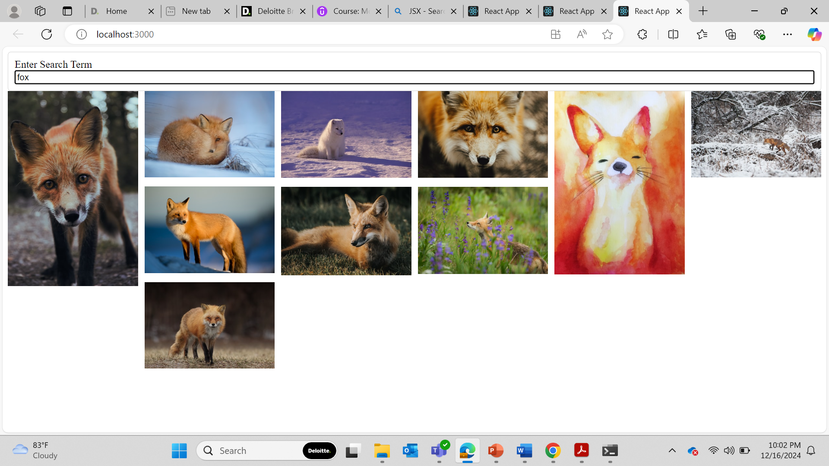
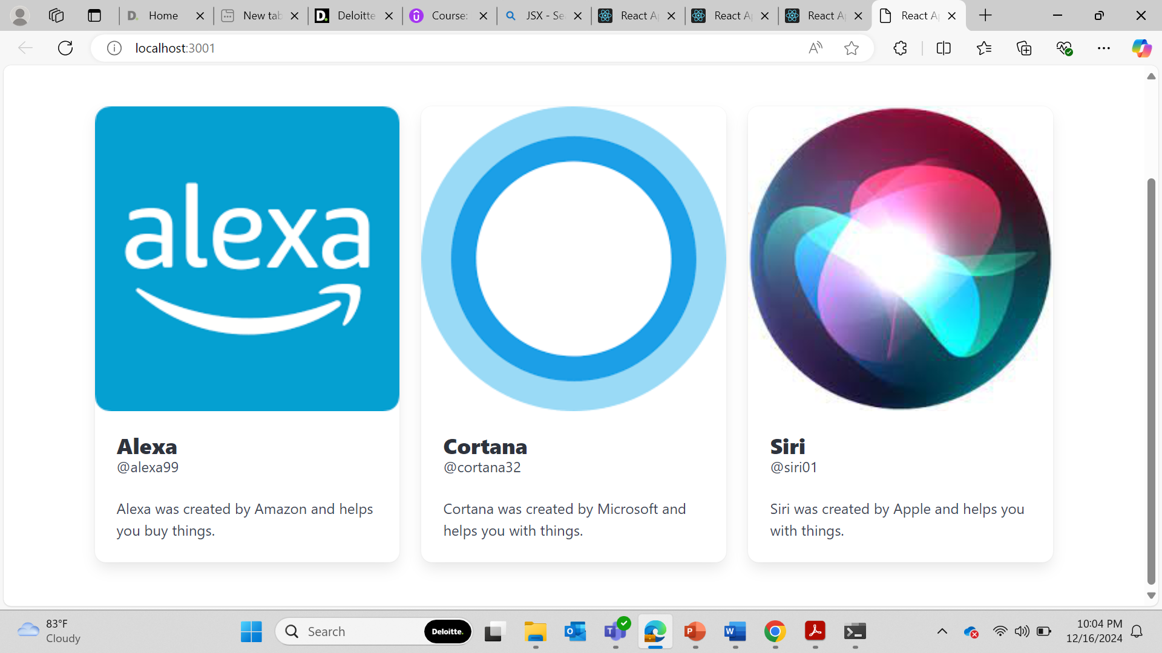
Technical Learning Path
Random Animal Voting App
Front-end Framework ( React JS )
Learning Course on Udemy
Photo Book Library
Photo Search Engine
Tailwind CSS UI

Slide 4
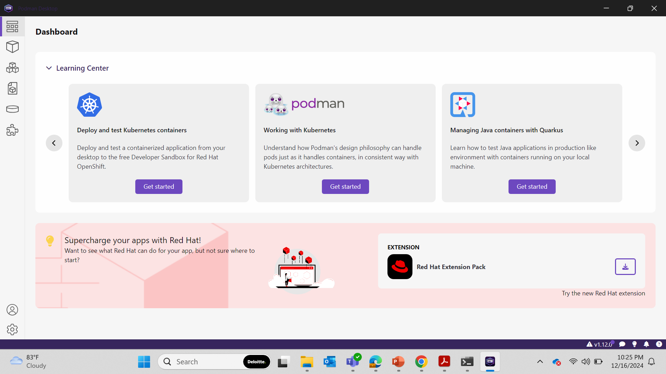

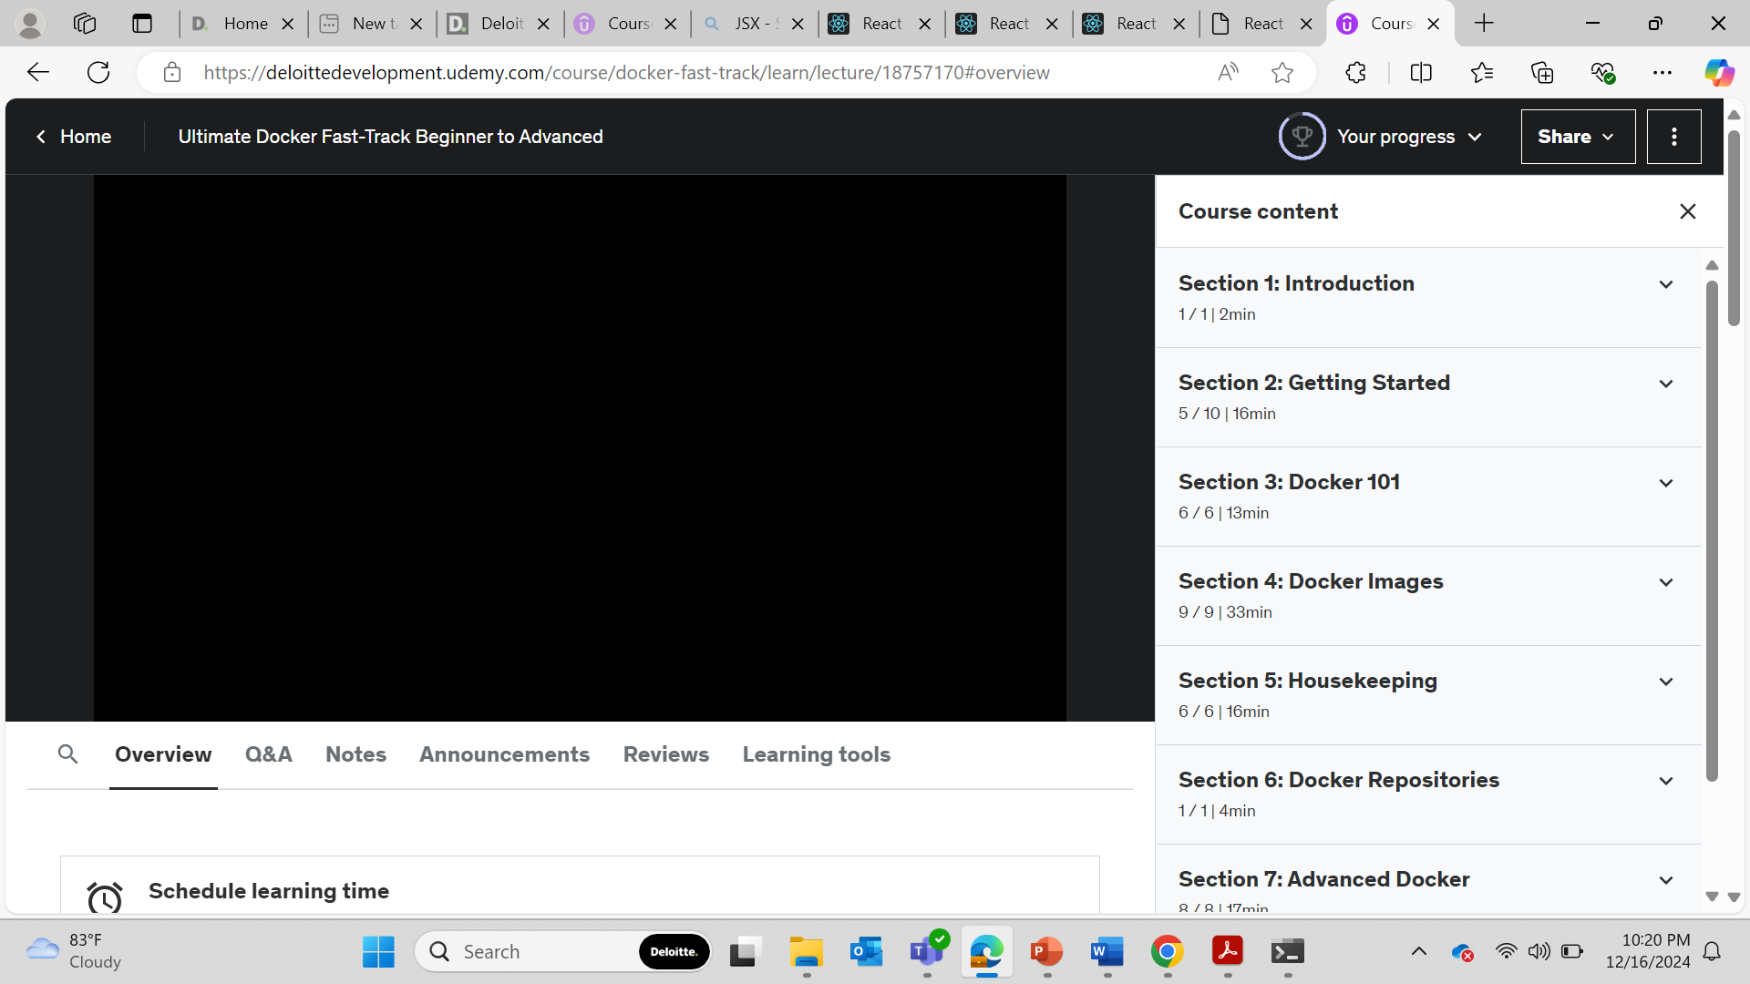
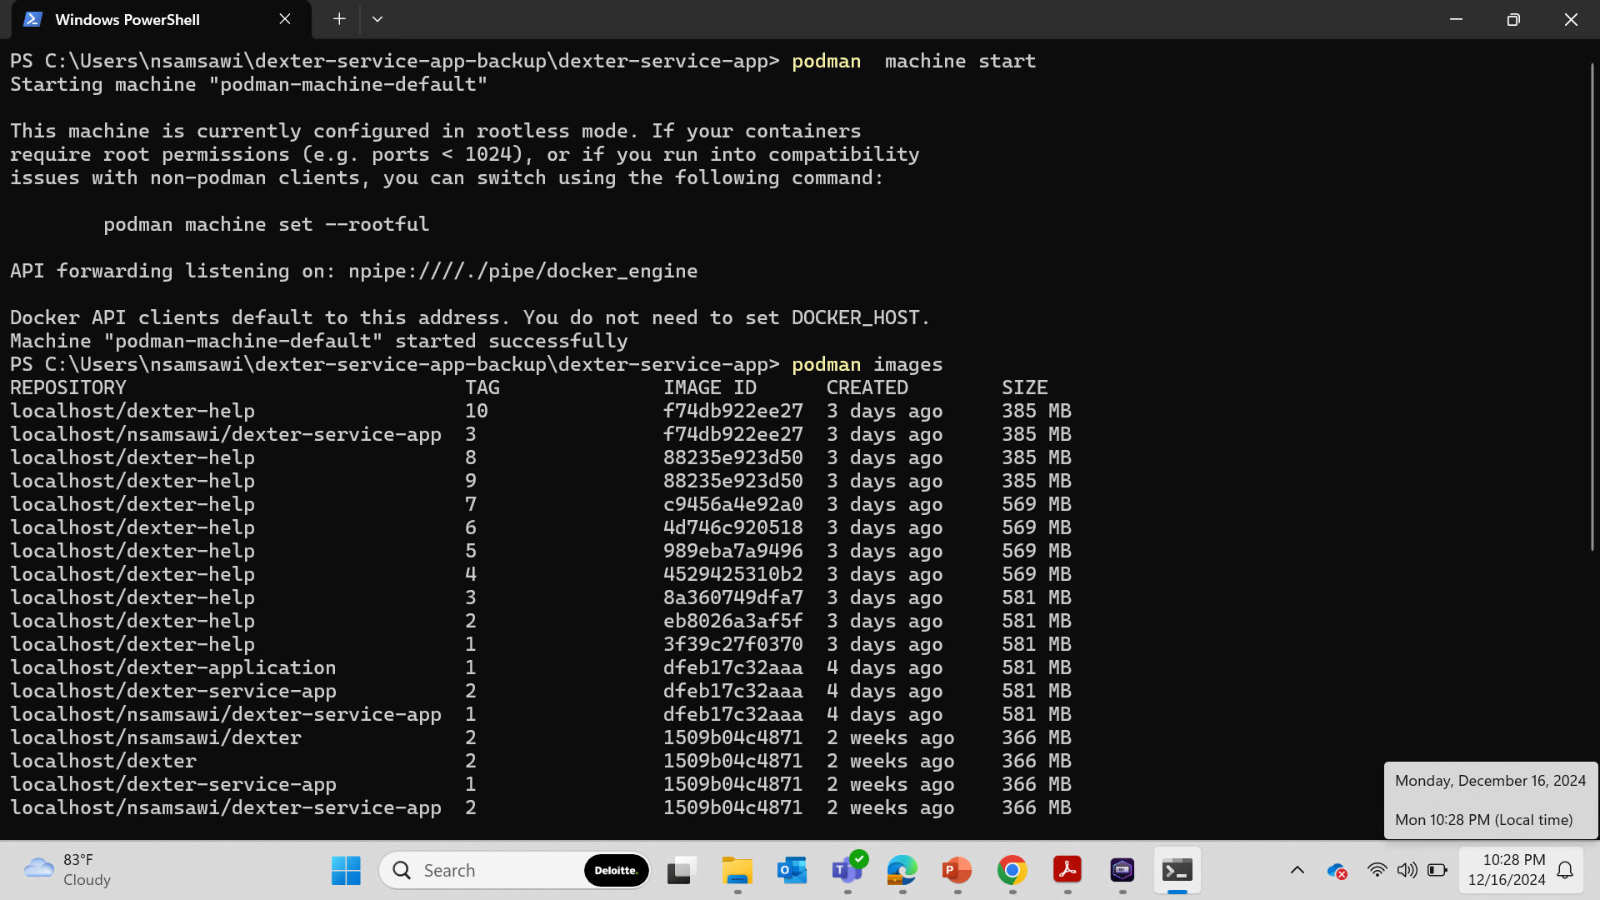
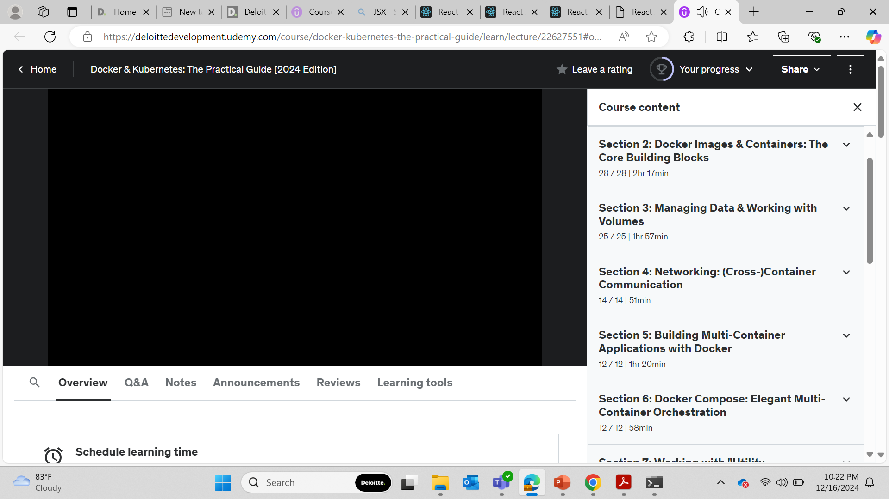

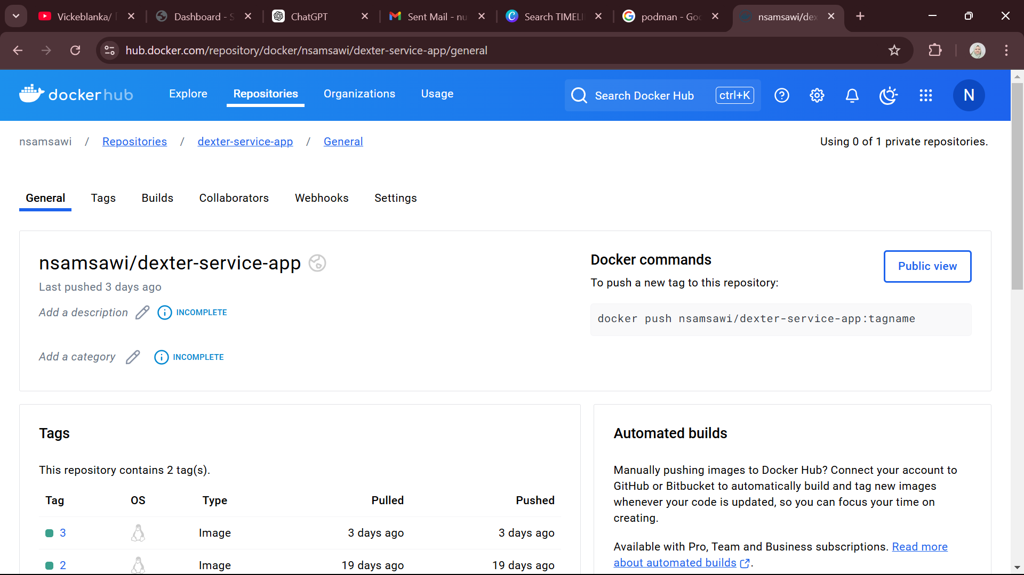
Technical Learning Path
Podman Desktop
Application Environment ( Docker )
Udemy : Docker Fast Track
Podman Command
Udemy : Docker & Kubernetes
Docker Hub Integration

Slide 5
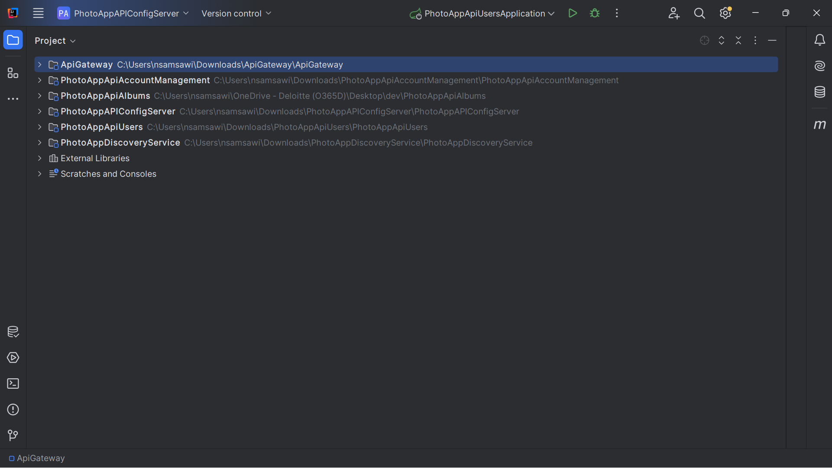
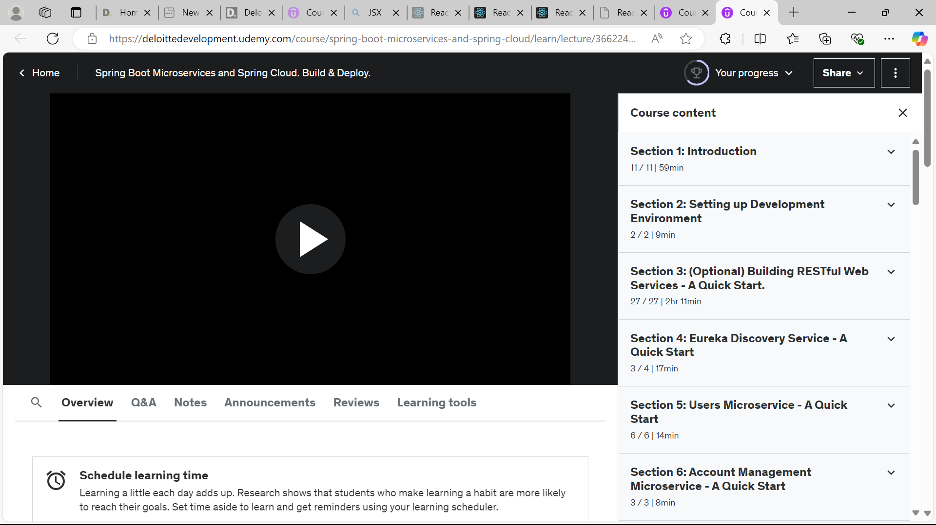

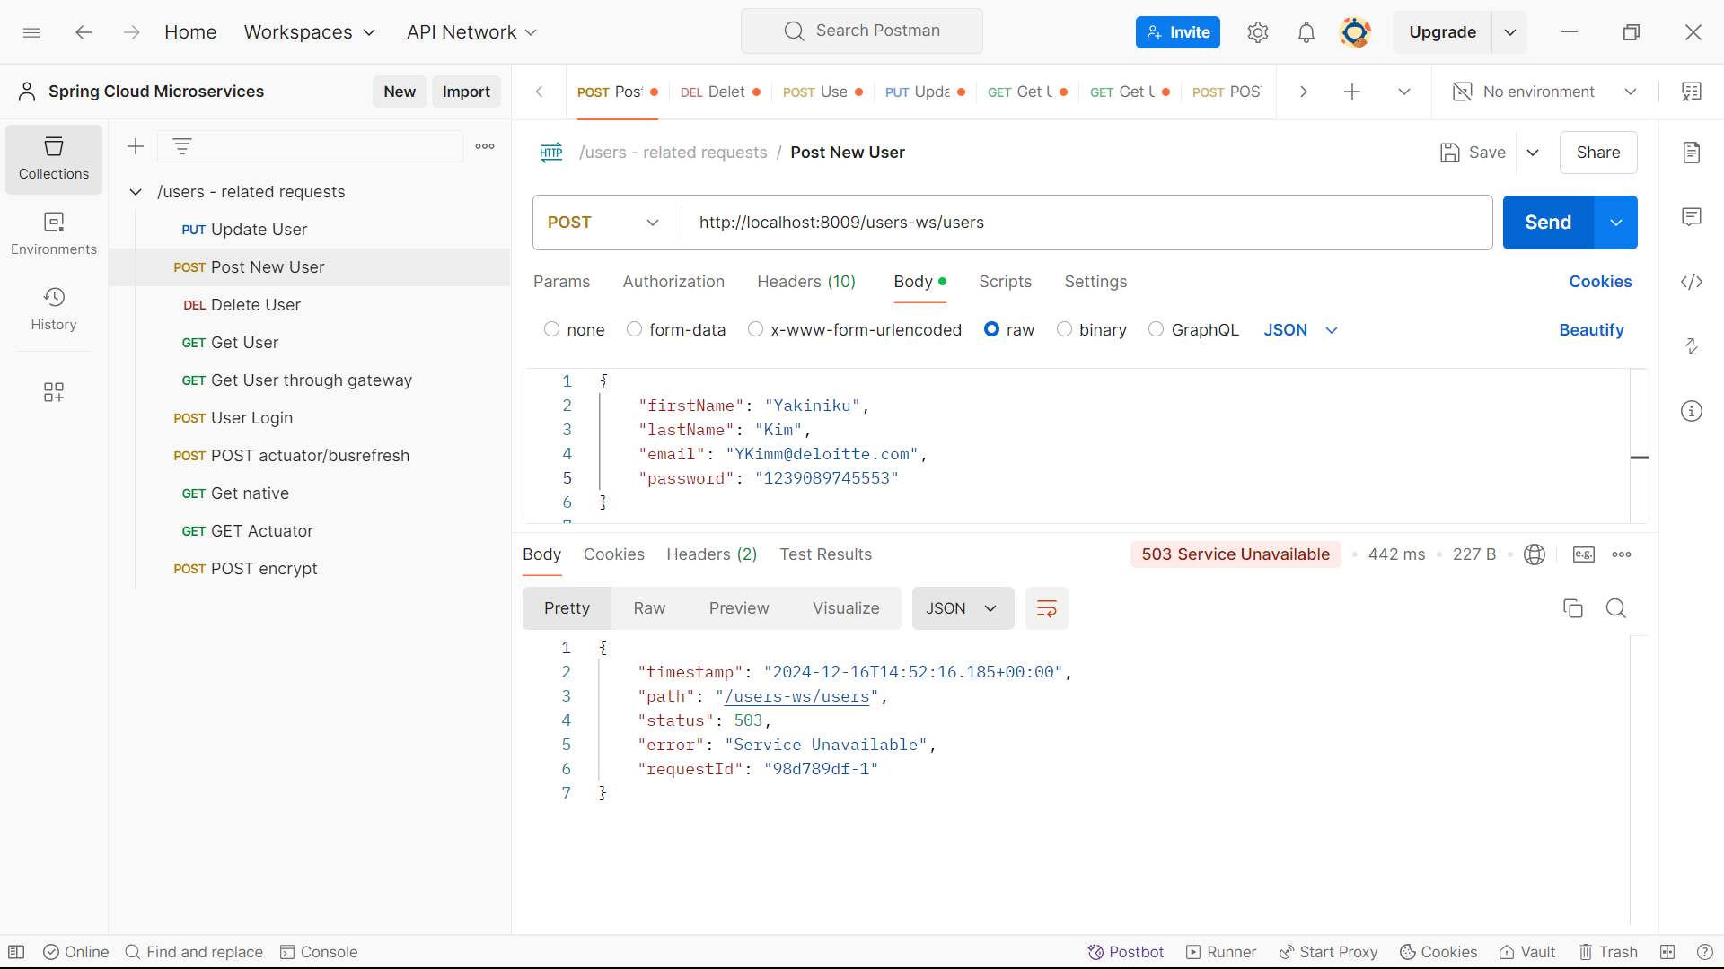
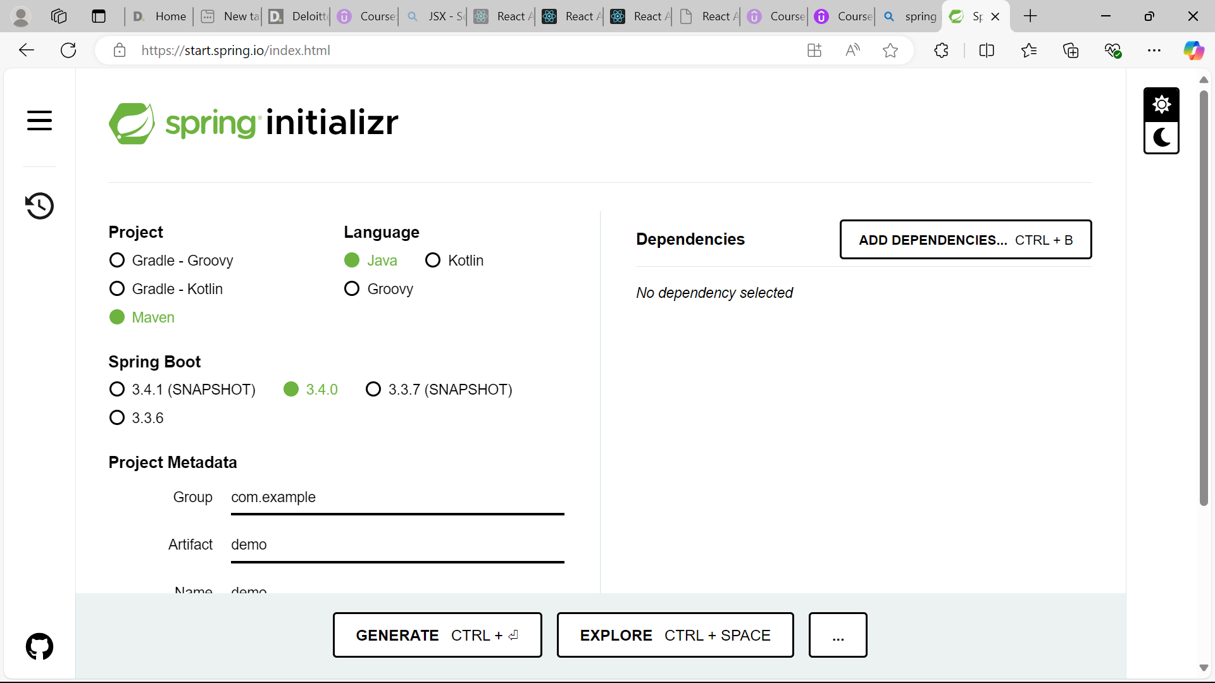

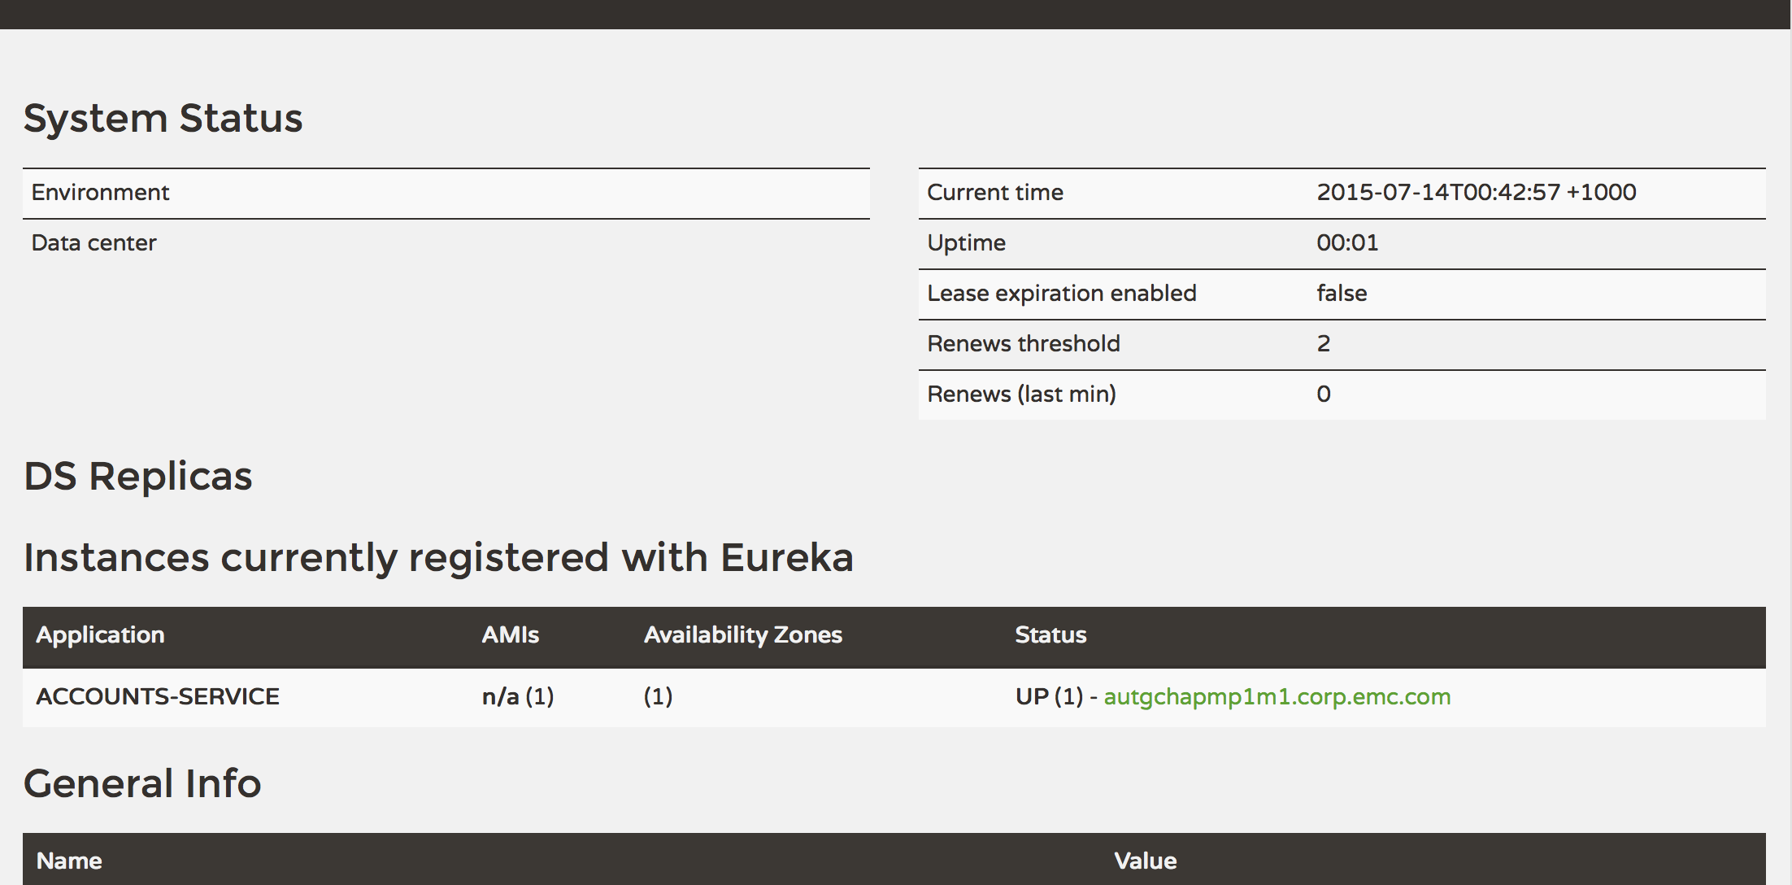
Technical Learning Path
Back-end Framework ( Spring Boot )
Learning Course on Udemy
Microservices
Spring Initializr
Postman
API Gateway

Slide 6


Dexter Ticketing Support System
Anastasia Nur Izati, Nur Syazwani | December 2024

Slide 7
Features
The capabilities of the project
Admin
Create new employee
Assign role to the employee
Agent
Pick new ticket and become the assigned agent
Update ticket status and read ticket details
Send message to ticket owner (user)
Receive notification on new ticket and message from user
User
Create new ticket
Track ticket status and read ticket details
Send message to assigned agent
Receive notification on ticket update and message from agent

Slide 8






Technology
Tools used in the project
Shadcn
Vite + React
Development tools and frameworks
Backend services and APIs
CSS styling framework
Version control and CI/CD pipeline
Containerization and standardized deployment

Slide 9
Feature Overview
Glimpse of main functions

Slide 10
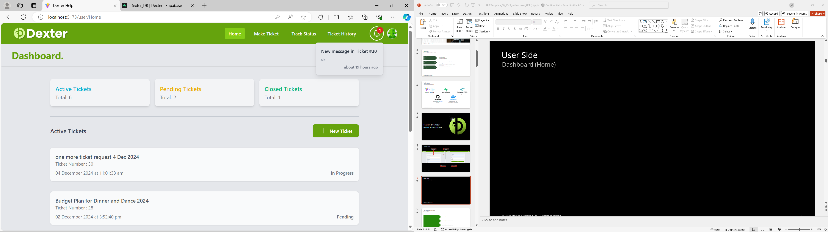
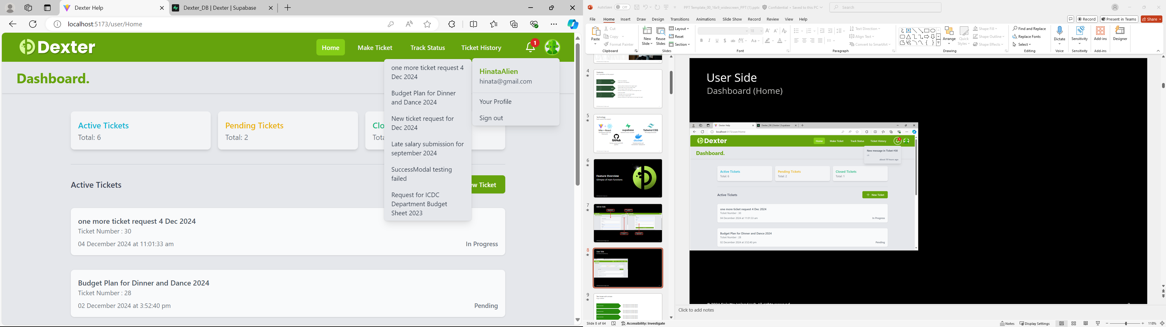
User Side
Dashboard (Home)
Navigation Bar with notification bell and profile badge
Notification bell. Onclick: dropdown notifications
Track Status button. Onclick: dropdown list of active tickets
Profile badge. Onclick: dropdown link to “Your Profile” page and sign out button
Make new ticket. Onclick: direct to “Make Ticket” page
Notifications. Onclick:
direct to the ticket’s “Track Status” page
List of active tickets. Onclick:
direct to the ticket’s “Track Status” page

Slide 11
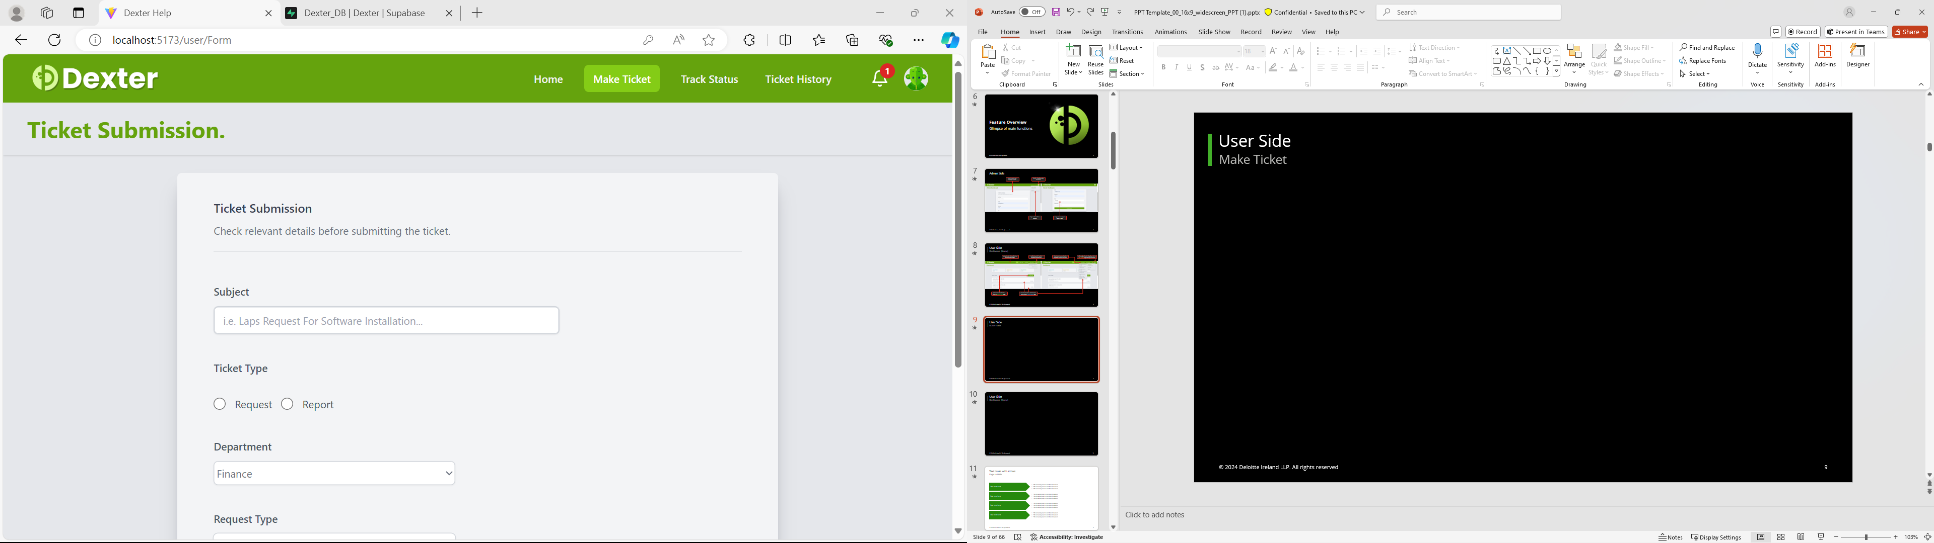
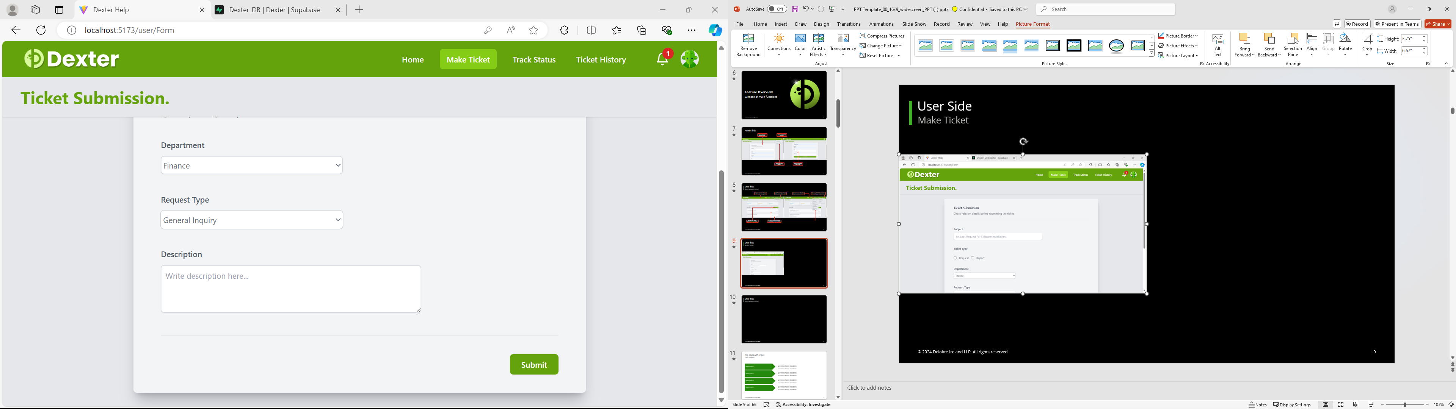
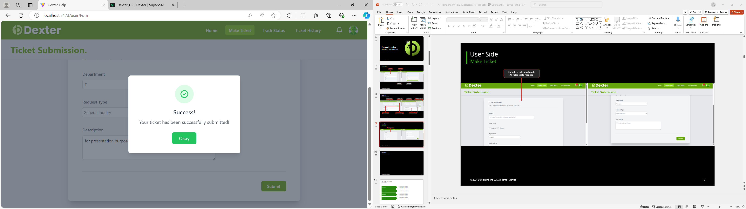
User Side
Make Ticket
Form to create new ticket.
All fields set to required
Submit ticket button. Onclick :
Insert new ticket to Database and display “success alert”
Success alert after ticket Submission. “Okay” button Onclick: direct user to “Home” page

Slide 12
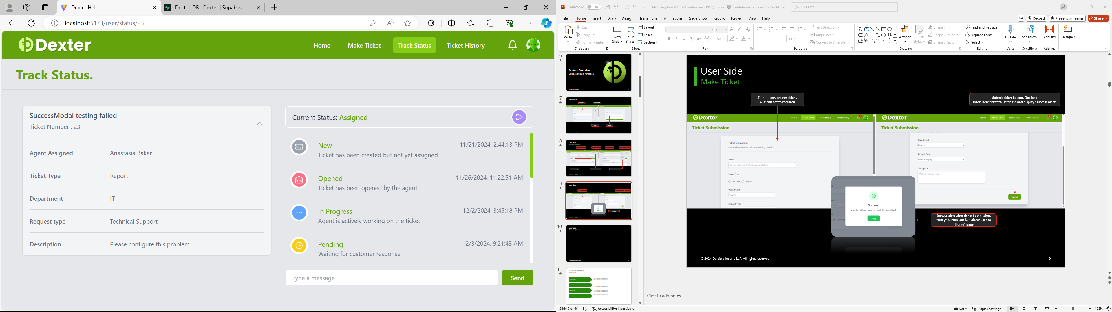
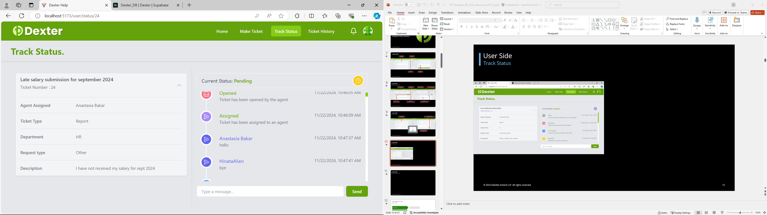
User Side
Track Status
Ticket Details. Onclick: toggle expand container
Ticket current Status
Message from assigned agent and the user will appear in timeline
Ticket status timeline
(Track status)
Message input field and “send” button.
Onclick “send” button: insert message to database

Slide 13
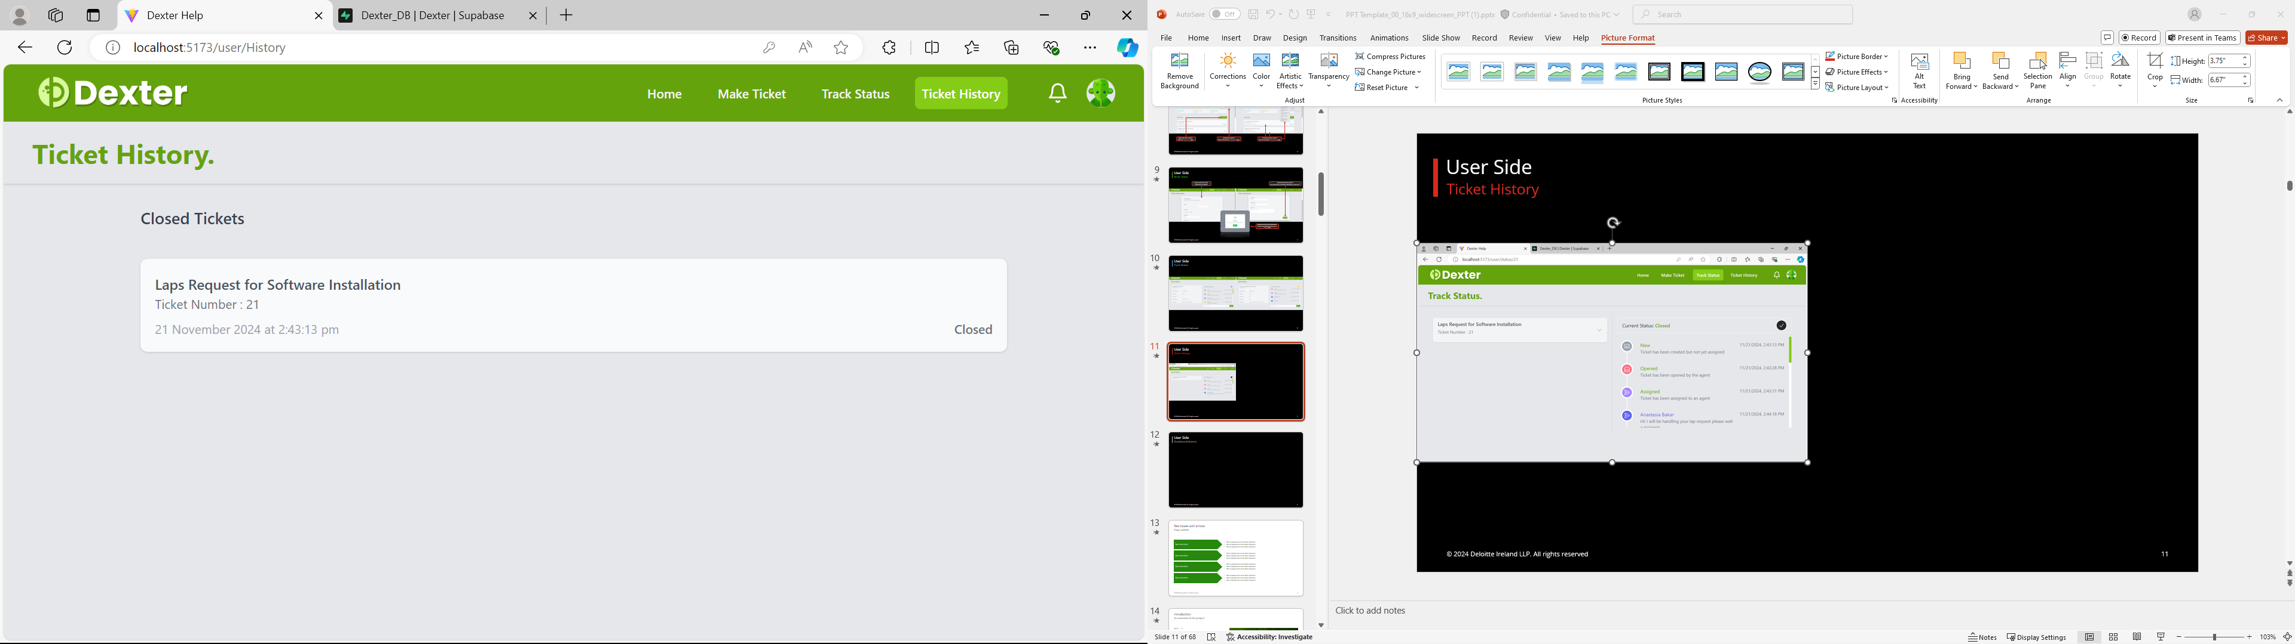
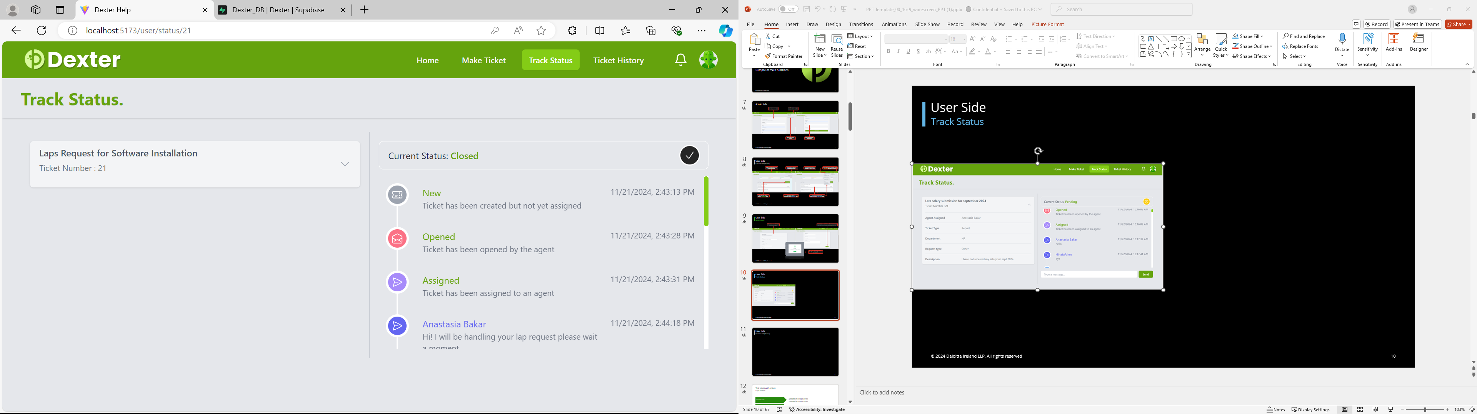
User Side
Ticket History
List of closed tickets. Onclick:
direct to the closed ticket’s “Track Status” page
In “closed” tickets’ “Track Status” page,
the difference is the Message input field and “send” button is unavailable.

Slide 14
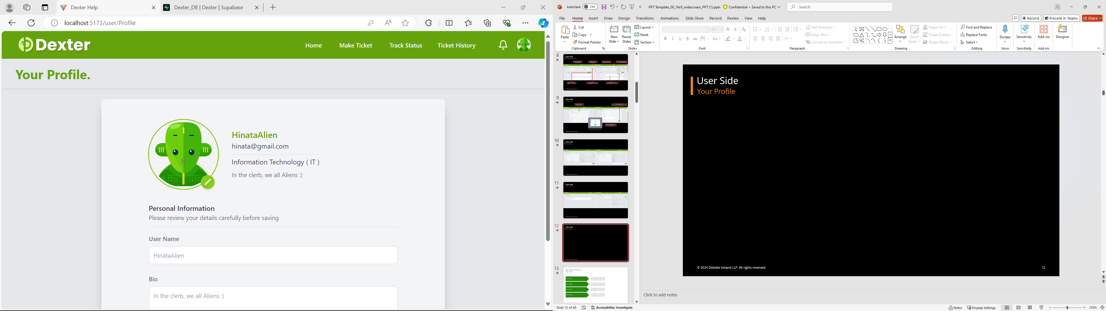
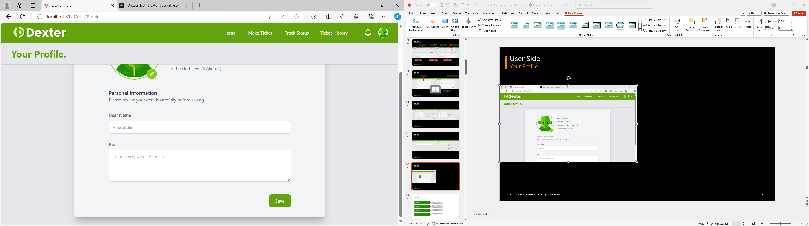
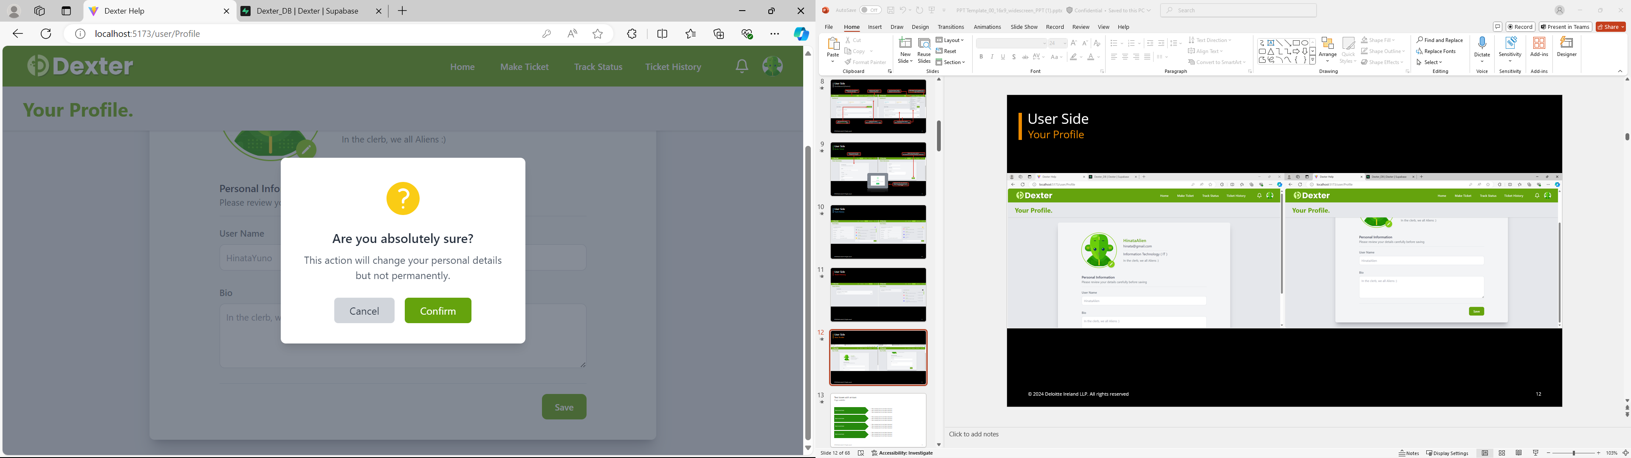
User Side
Your Profile
Form to edit user details. (avatar, username and bio only)
Save profile button. Onclick :
display “confirmation alert”
confirmation alert before profile update.
“cancel” button Onclick: no updates sent to database
“Confirm” button Onclick: updates sent to database
Update avatar button. Onclick: allow user to pick image from device as avatar

Slide 15
Architecture
Diagram and Storage Schema

Slide 16
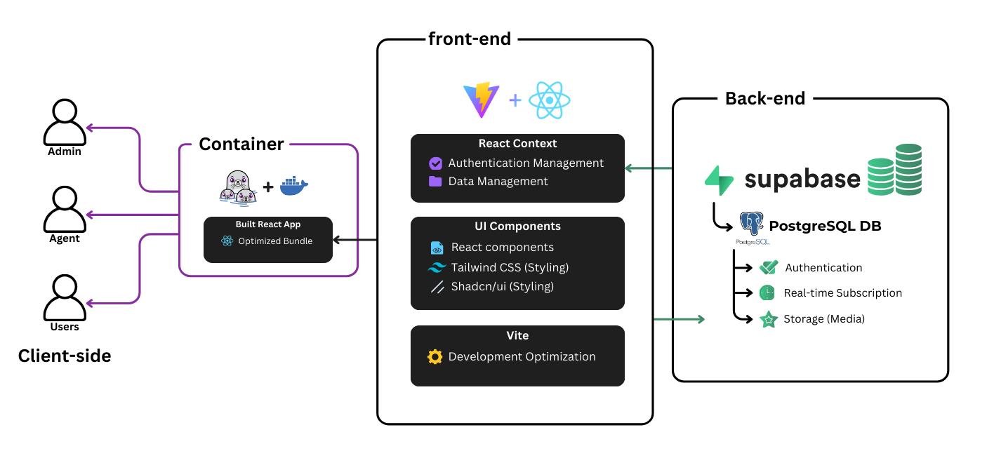
Architecture Diagram
Overview of development environment

Slide 17
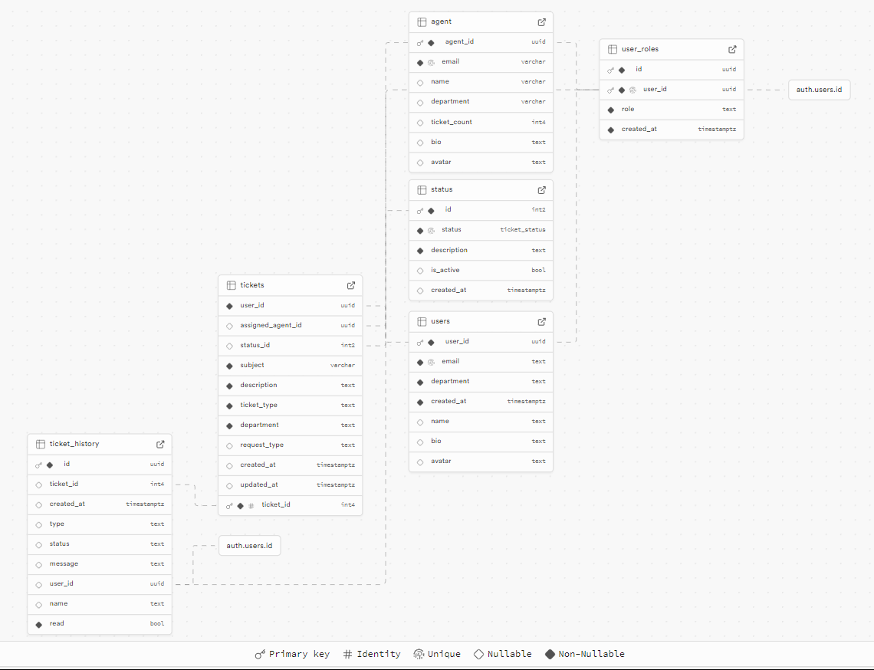
Storage Schema
Overview of storage environment

Slide 18
Thank You For Your Attention
Nur Syazwani Binti Samsawi | 2022876358

